Slide 1


Практикум на ЭВМ.
Программирование под Android
Занятие 7

Slide 2
ADB

Slide 3
Android Debug Bridge
<sdk>/platform-tools/
devices
install/uninstall
pull/push
shell
logcat
Notes:
SQLite

Slide 4
Hierarchy Viewer

Slide 5
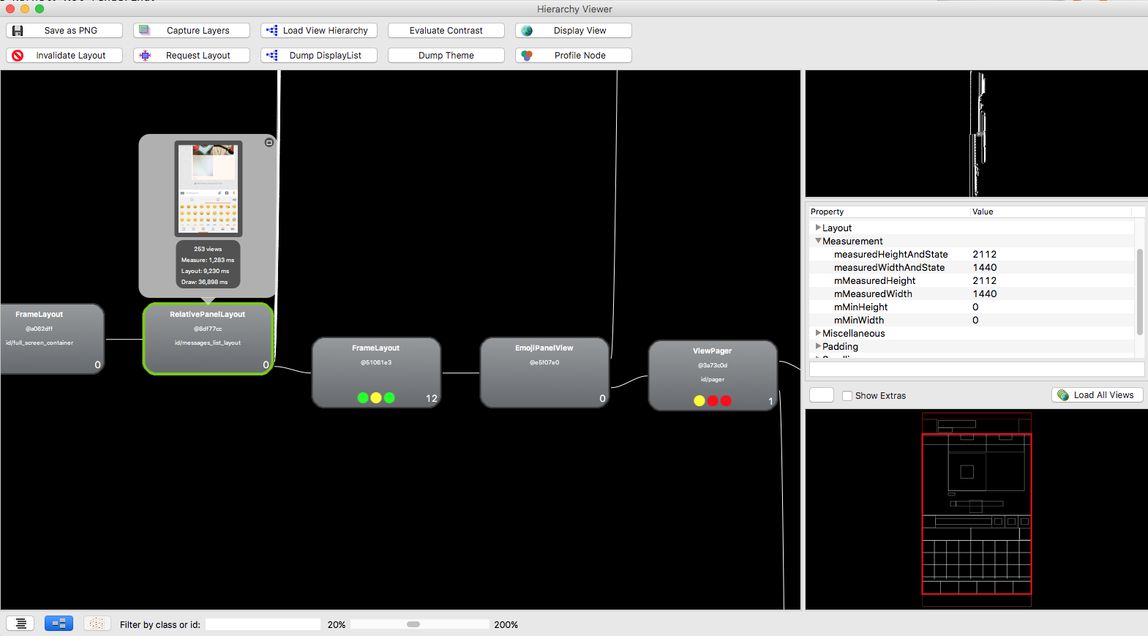

Slide 6
Overdraw

Slide 7
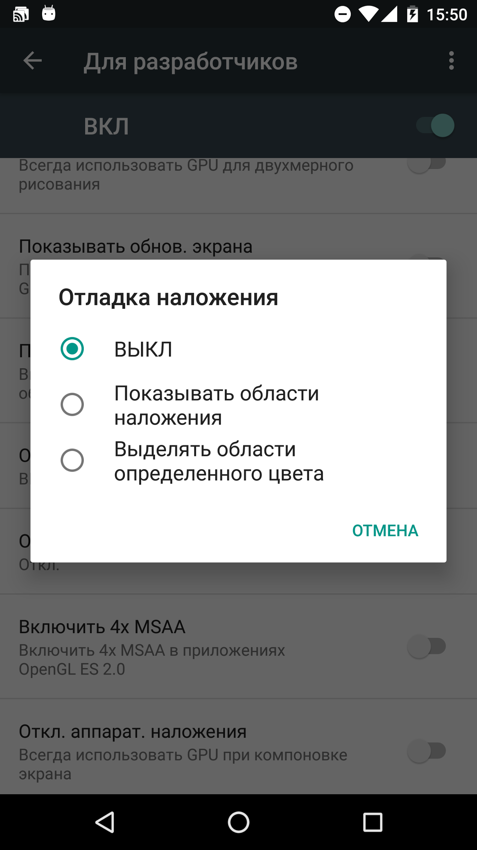

Slide 8
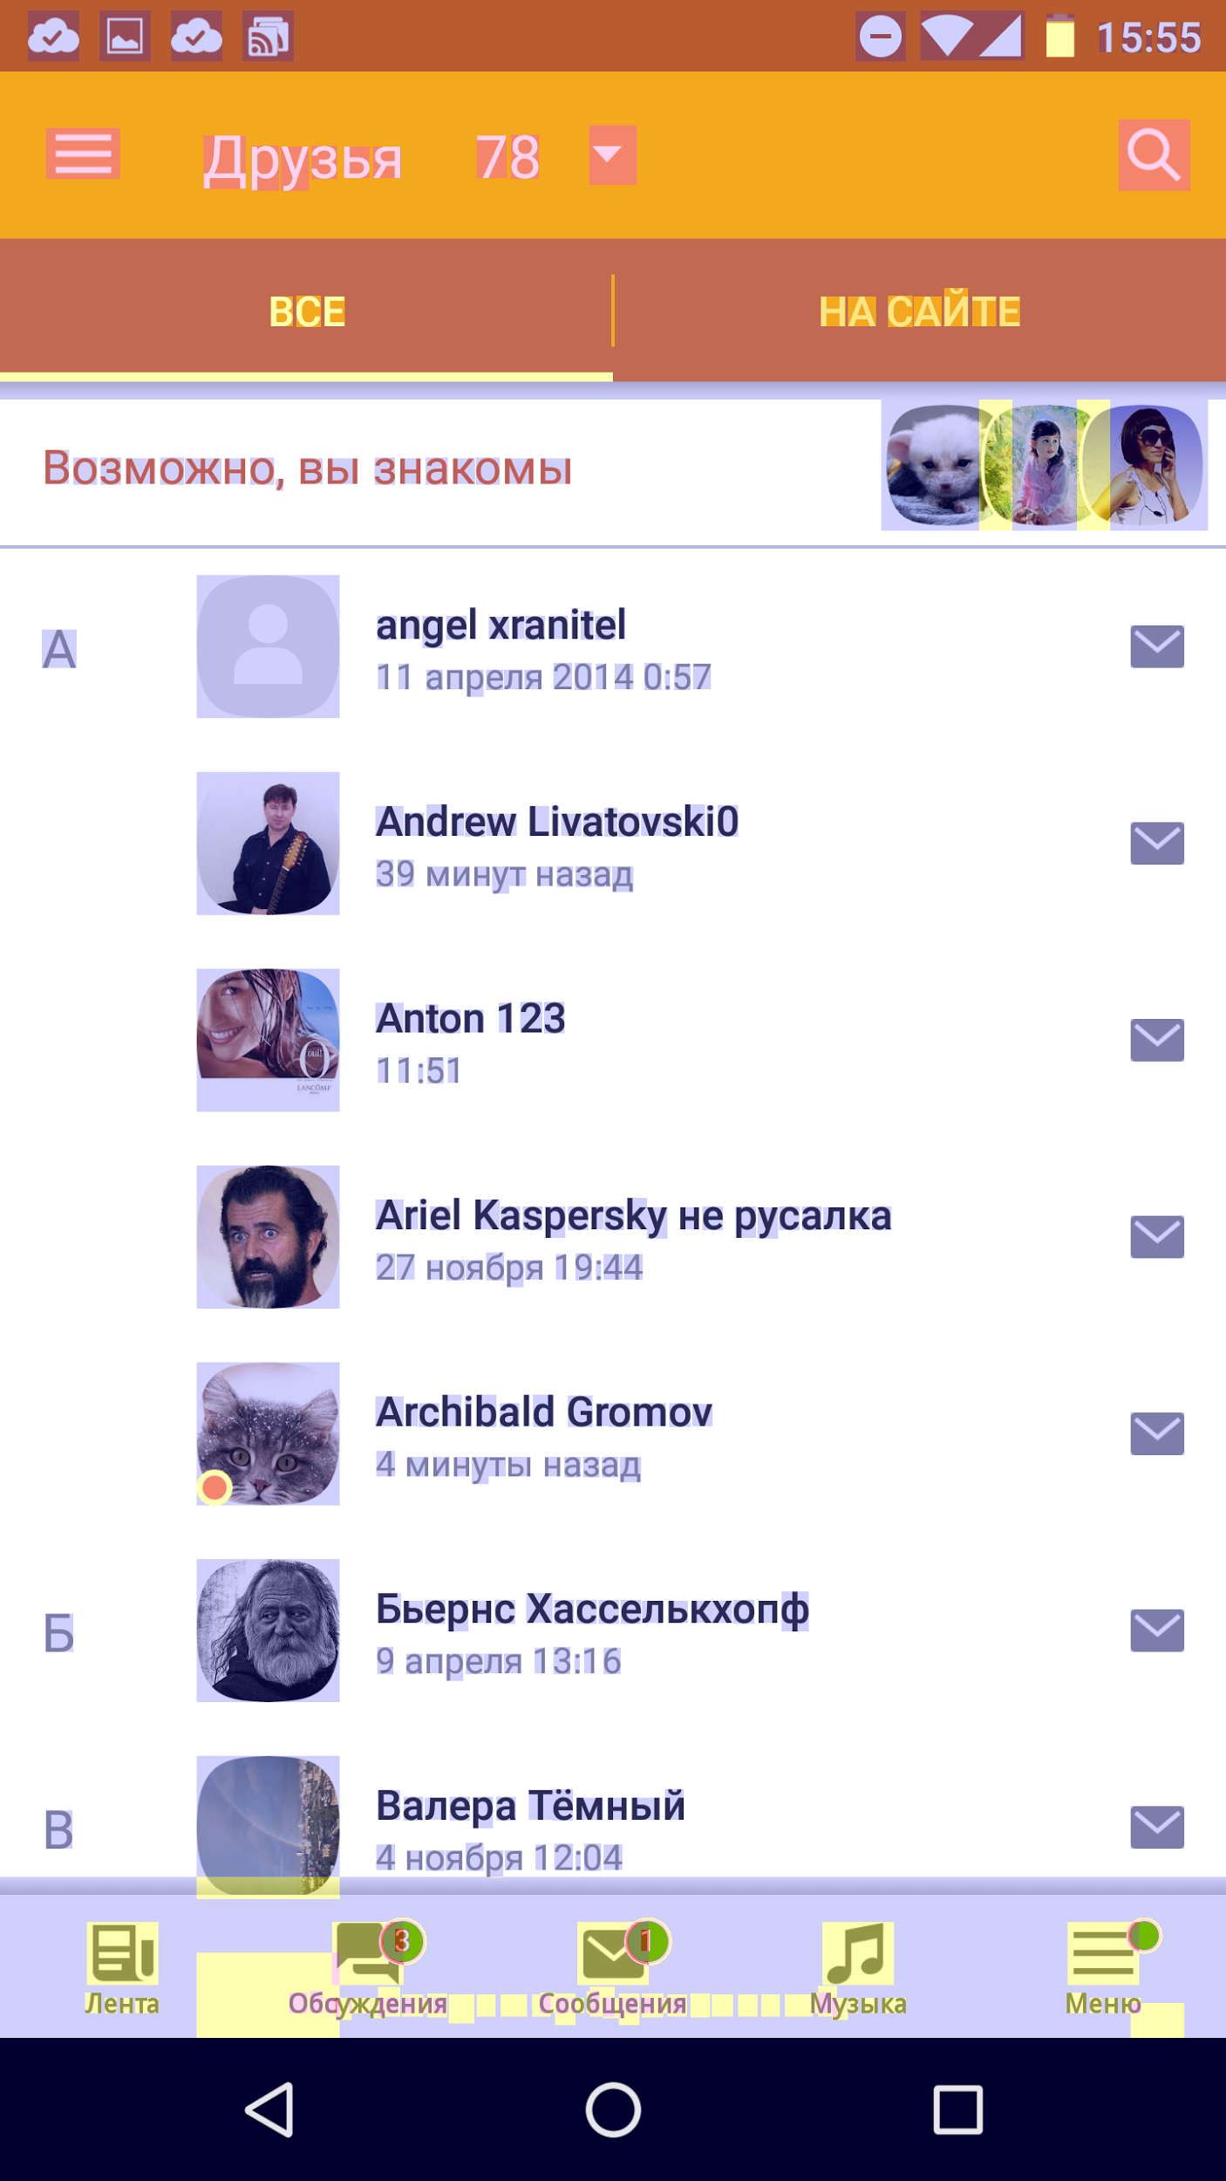
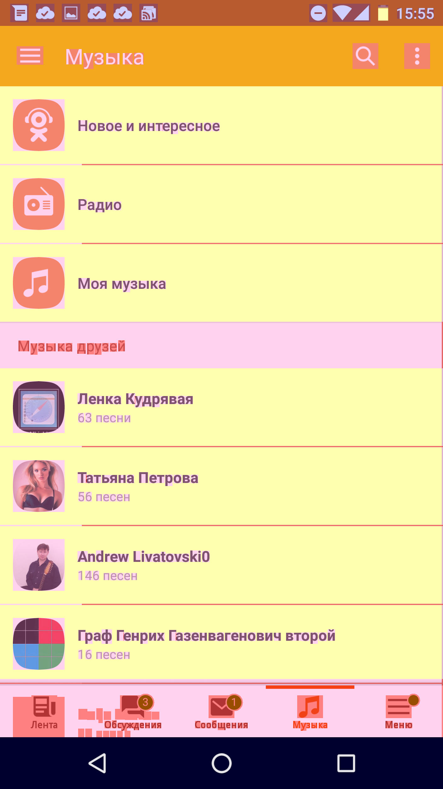

Slide 9
Memory Analyzer

Slide 10
public final class LeakActivity extends Activity { private byte [] array = new byte [10_000_000]; @Override protected void onCreate(Bundle savedInstanceState) { super.onCreate(savedInstanceState); new AsyncTask<Void, Void, Void>() { @Override protected Void doInBackground(Void... params) { try { Thread.sleep(30_000); } catch (InterruptedException e) { } return null; } }.execute((Void)null); } }

Slide 11
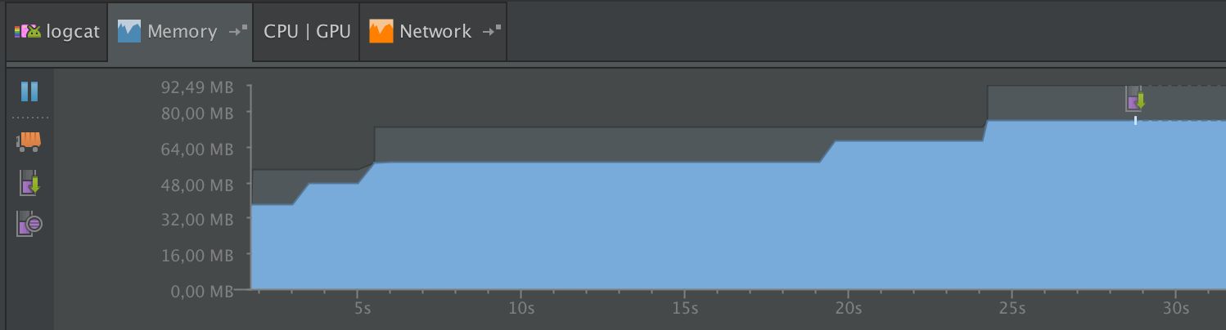

Slide 12
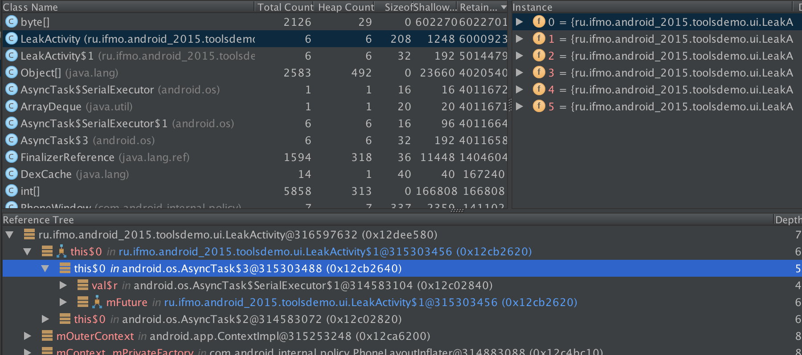

Slide 13
ArrayMap

Slide 14
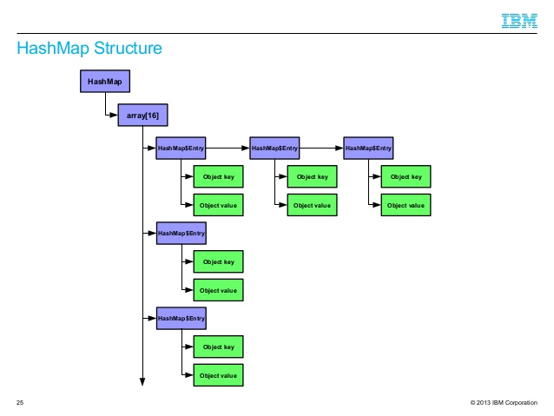
HashMap

Slide 15
ArrayMap
public final class ArrayMap<K, V> implements Map<K, V> { ... int[] mHashes; Object[] mArray; // keys & values int mSize; ... }

Slide 16
SparseArray
public class SparseArray<E> implements Cloneable { ... private int[] mKeys; private Object[] mValues; private int mSize; ... }

Slide 17
Versus
for (int i = 0; i < 1_000_000; i++) { hashMap.put(i, new Object()); // 52 387 120 arrayMap.put(i, new Object()); // 32 062 208 sparseArray.put(i, new Object()); // 16 388 605 }

Slide 18
WeakReference

Slide 19
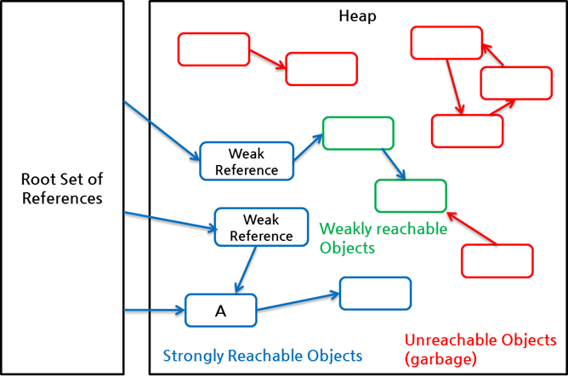

Slide 20
private static class MyAsyncTask extends AsyncTask { private final WeakReference<Activity> activityRef; public MyAsyncTask(Activity activity) { this.activityRef = new WeakReference<>(activity); } @Override protected void onPostExecute(Void aVoid) { super.onPostExecute(aVoid); Activity activity = activityRef.get(); if (activity != null) { ... } } }

Slide 21
Proguard

Slide 22
Proguard
Удаляет неиспользуемый код
Оптимизирует
“Запутывает”
Notes:
SQLite

Slide 23
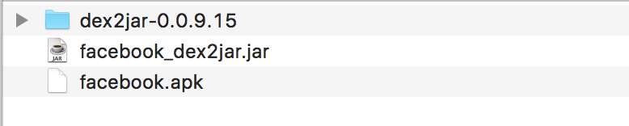
dex2jar
Вытаскивает jar из apk

Slide 24
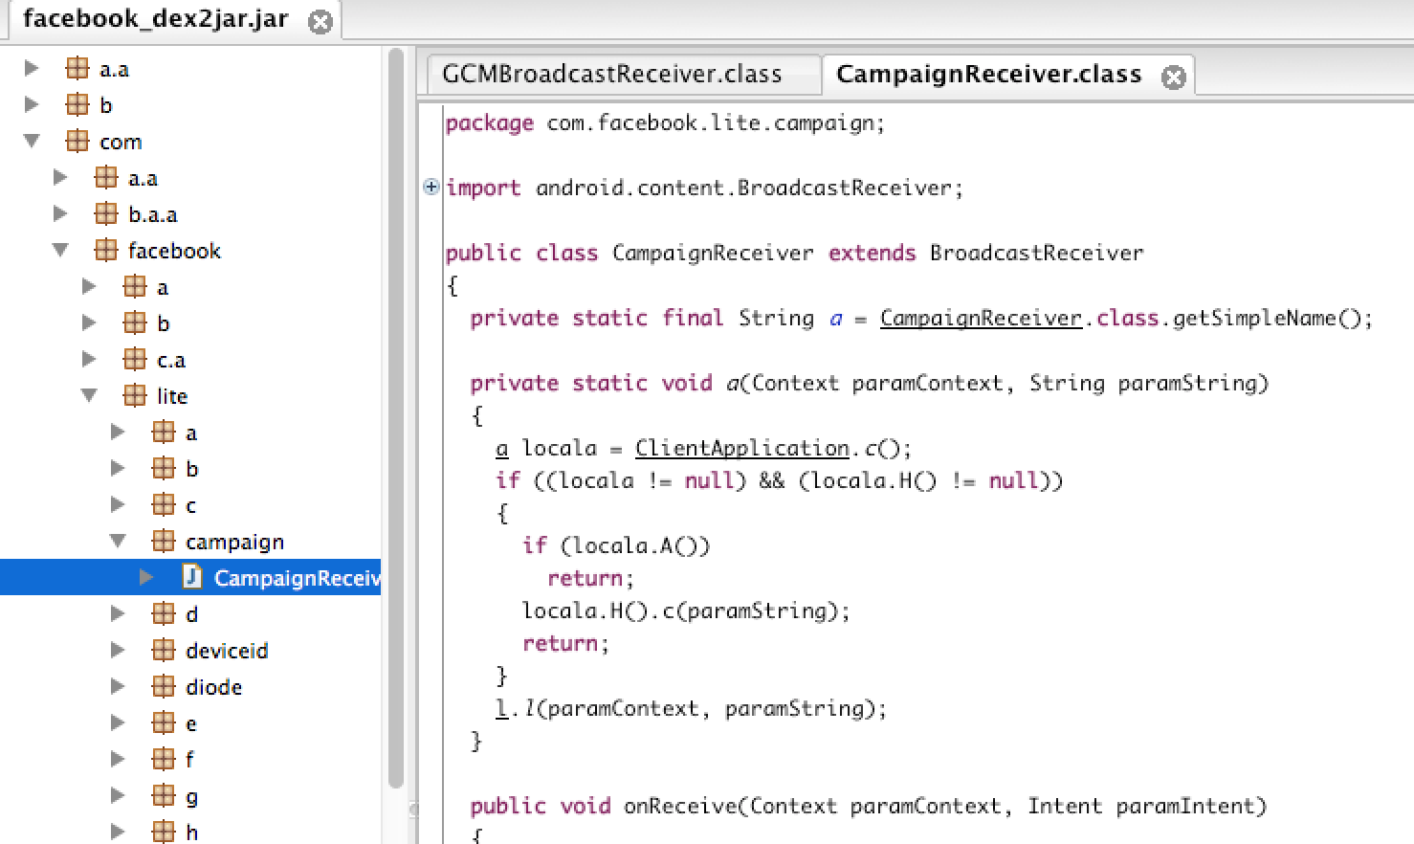
dex2jar

Slide 25
build.gradle
buildTypes { release { minifyEnabled true proguardFiles
getDefaultProguardFile('proguard-android.txt'),
'proguard-rules.pro' } }

Slide 26
Вопросы?

